Slide 1


Welcome To Our Presentation
Semester: Summer 2025
Course Code : CSE 303
Course Title : Statistics for Data Science
Topic
Predict the age of marine creatures from physical measurements
- Comparative Analysis of Abalone and Crab Age Prediction
Presented to :
Dr. Mohammad Manzurul Islam
Assistant Professor
Department of Computer Science & Engineering
01

Slide 2




Presented By
Md Maruf Hasan
ID-2021-3-60-101
Abdul Muhaimin Ibne Ali
ID-2021-3-60-172
Chinmoy Karmakar
ID-2022-1-60-381
02

Slide 3
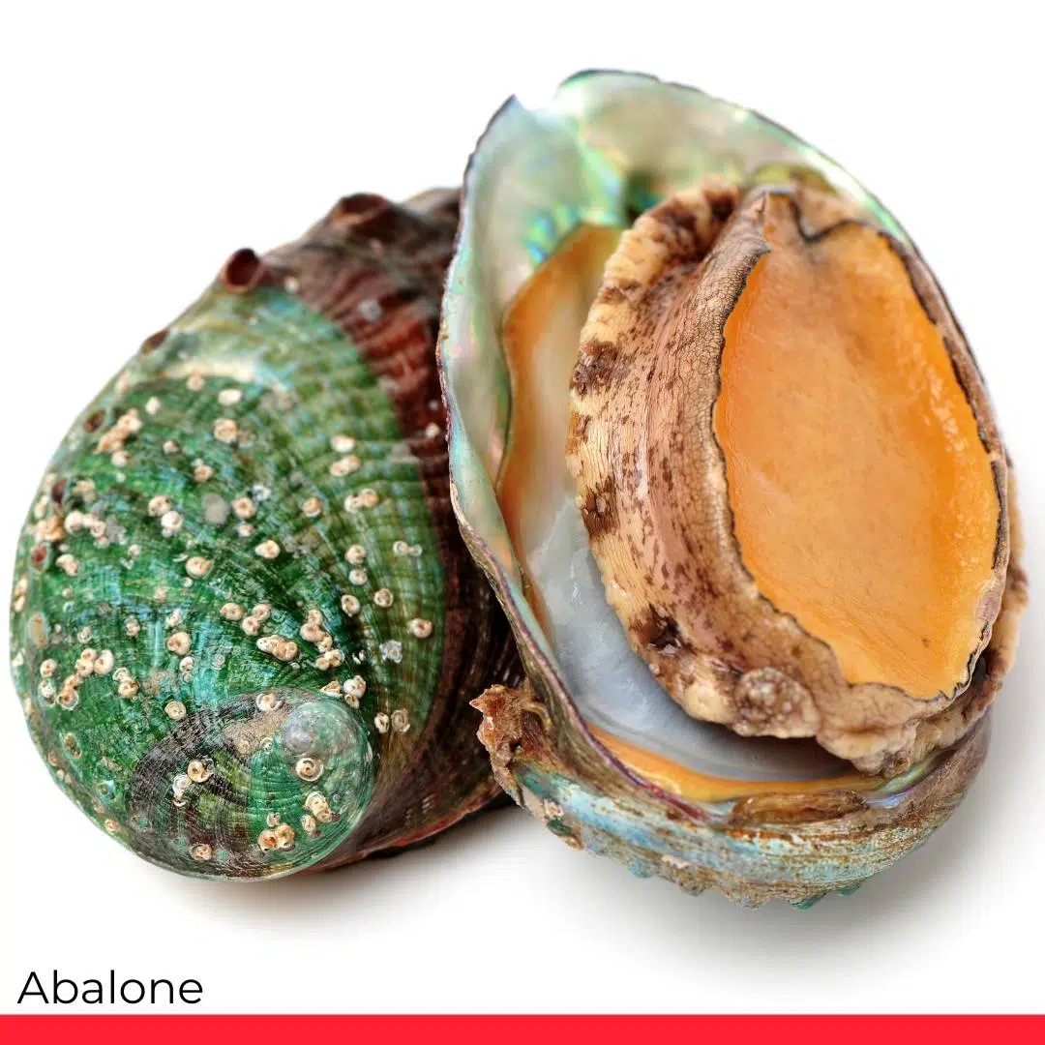

01
INTRODUCTION
We use machine learning to predict the age of marine creatures, such as Abalones and Crabs, from their physical features.
03

Slide 4


Problem Statement & Our Solution Approach
Problem Statement
Our Solution Approach
Traditional methods of determining the age of marine species, such as counting shell rings, are destructive, slow, and costly.
We combine machine learning with marine biology to predict the age of marine creatures.
To get accurate results, we test multiple algorithms : Linear Regression, Logistic Regression, and Support Vector Regression (SVR) and compare their performance.
04

Slide 5
Dataset Specifications
Aspect | Abalone Dataset (UCI) | Crab Age Dataset (Kaggle)
Source | UCI Repository | Kaggle
Shape | 4,177 rows × 9 columns | 3,893 rows × 9 columns
Data Types | 7 float, 1 int, 1 categorical | 7 float, 1 int, 1 categorical
Target Variable | Rings → Age = Rings + 1.5 years | Age (direct years)
Sex Categories | M (Male), F (Female), I (Infant) | F (Female), M (Male), I (Infant)
Size Features | Length, Diameter, Height (mm) | Length, Diameter, Height (mm)
Weight Features | Whole Wt, Shucked Wt, Viscera Wt, Shell Wt (grams) | Weight, Shucked Wt, Viscera Wt, Shell Wt (grams)
05

Slide 6

Data Preprocessing
06

Slide 7
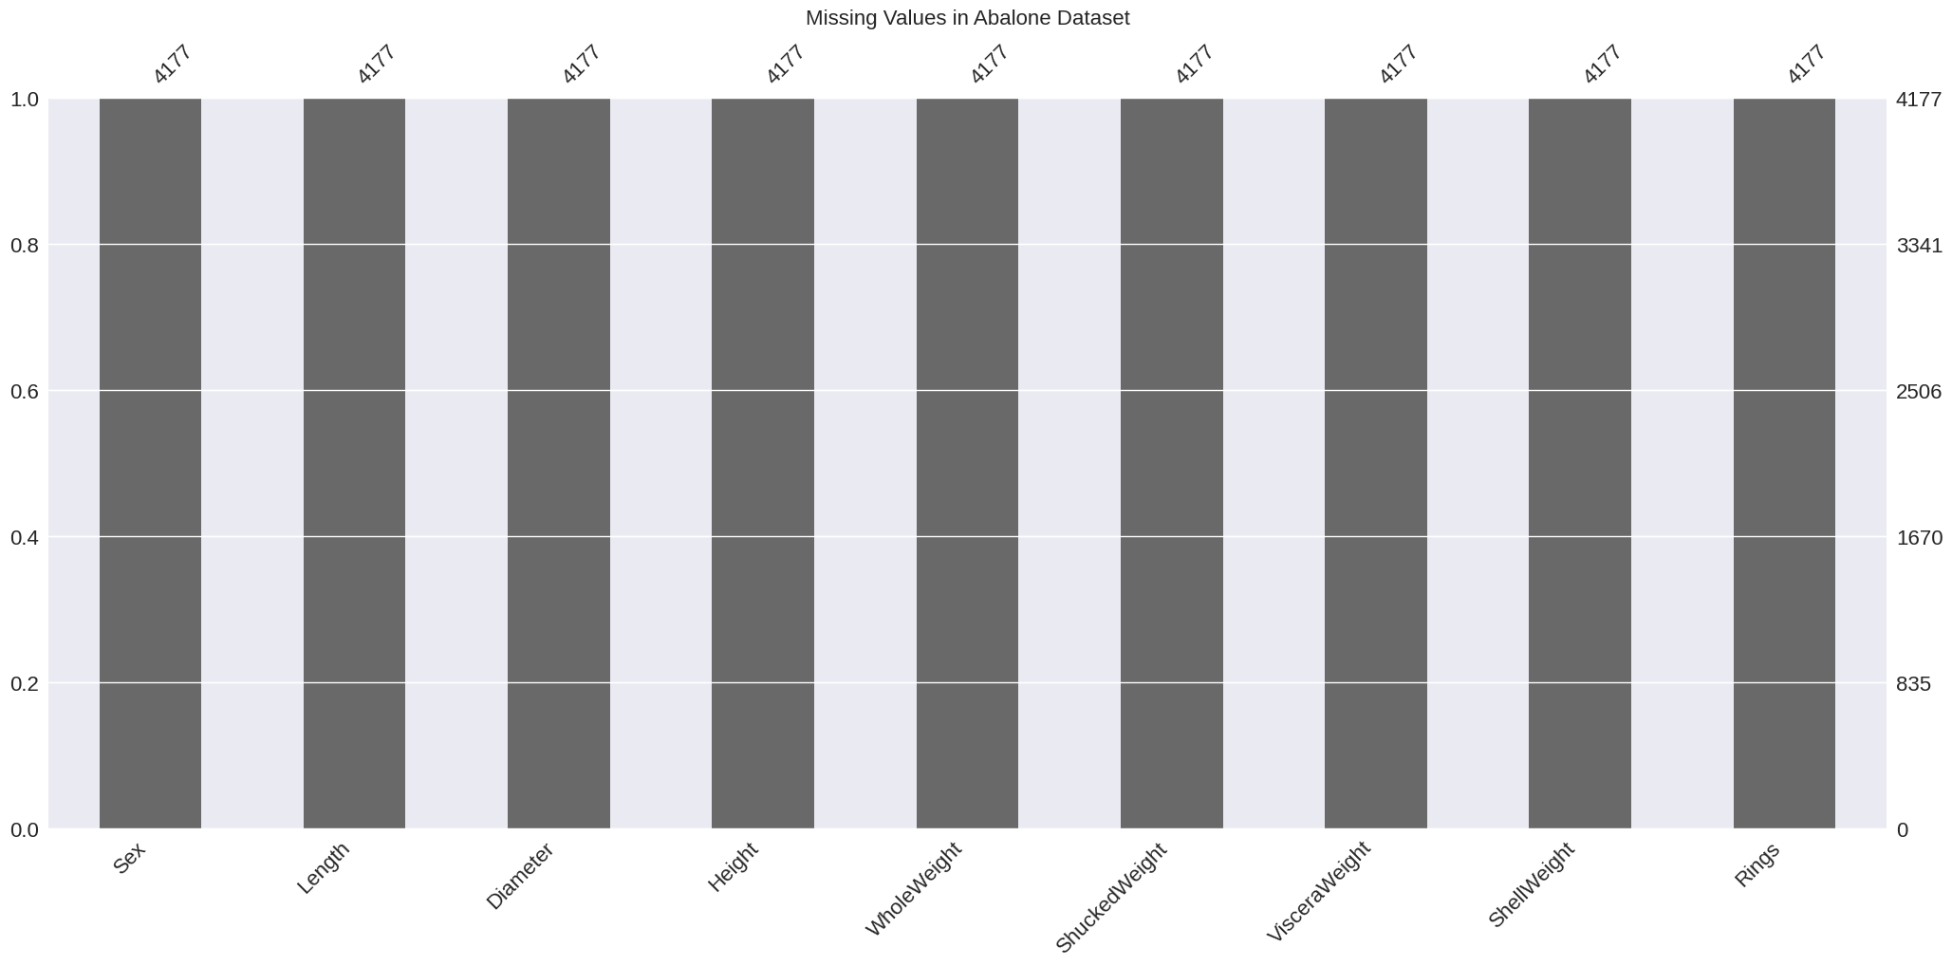
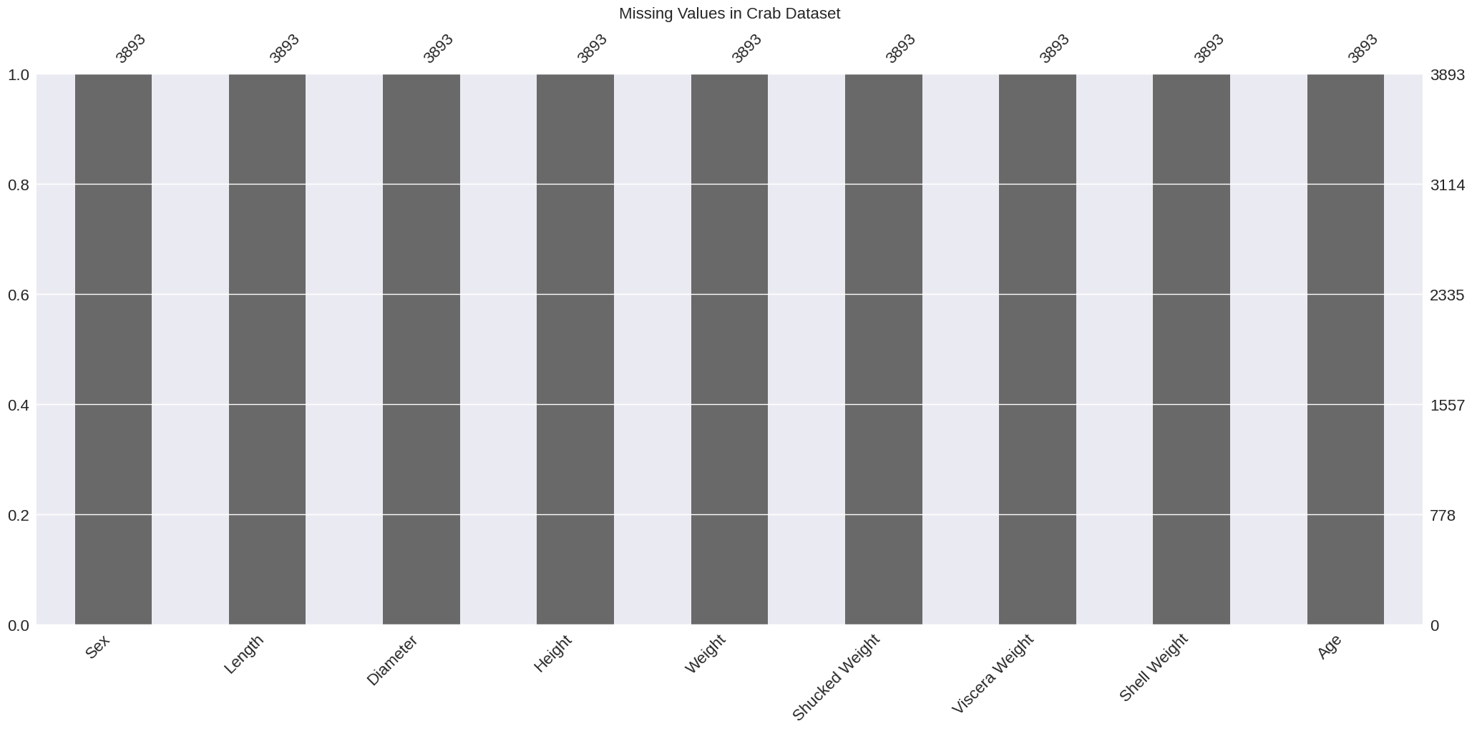
Missing Value Analysis
Aspect | Result
% Missing Values | 0%
Method | df.isnull().sum()
Visualization | missingno.bar()
Conclusion | Perfect Data Quality: No missing values in either dataset
07

Slide 8
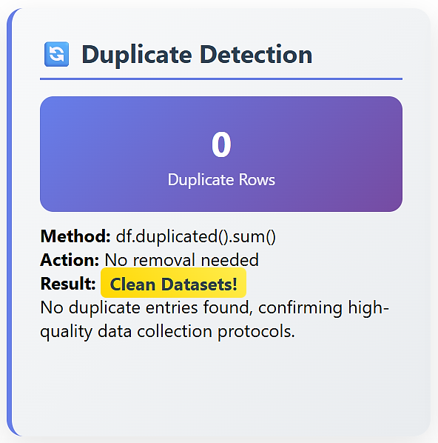
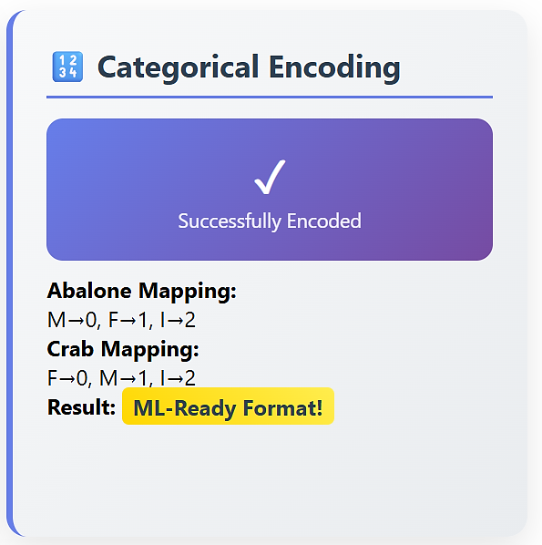
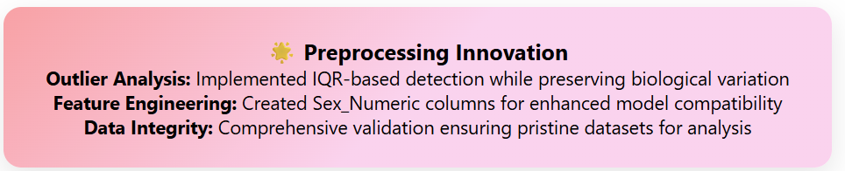
Duplicate Detection and Encoding
08

Slide 9

Exploratory Data Analysis: Visualizations
09

Slide 10
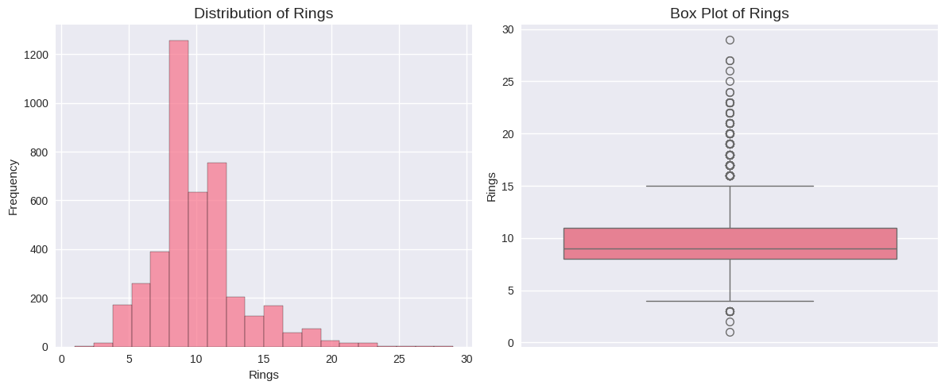
Exploratory Data Analysis: Visualizations
Distribution of Target Variable (Age/Rings) abalone:
Histograms and box plots showed that the age distribution in both datasets is skewed towards younger individuals. Outliers with higher ages were observed.
10

Slide 11
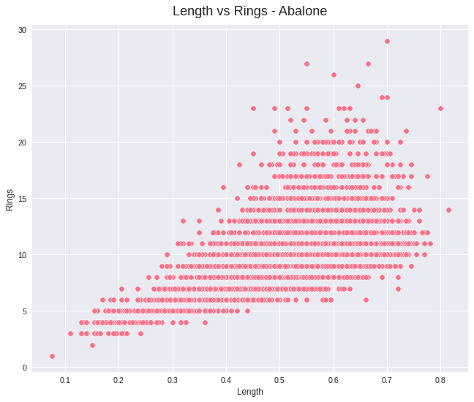
Exploratory Data Analysis: Visualizations
Scatter plot: Abalone Length vs Rings
We can observe a general positive trend, indicating that as the length of the abalone increases, the number of rings (and thus age) also tends to increase.
11

Slide 12
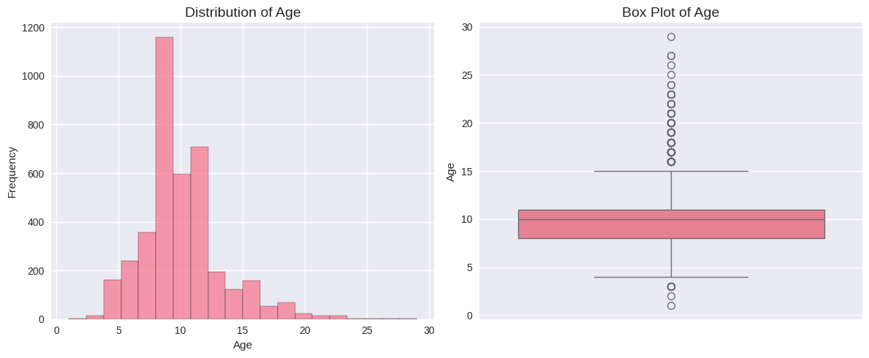
Exploratory Data Analysis: Visualizations
DATA VISUALIZATION : CRAB:
Similar to the Abalone dataset, the age distribution is skewed towards younger crabs, with fewer older individuals. The box plot also reveals outliers in the higher age ranges.
12

Slide 13
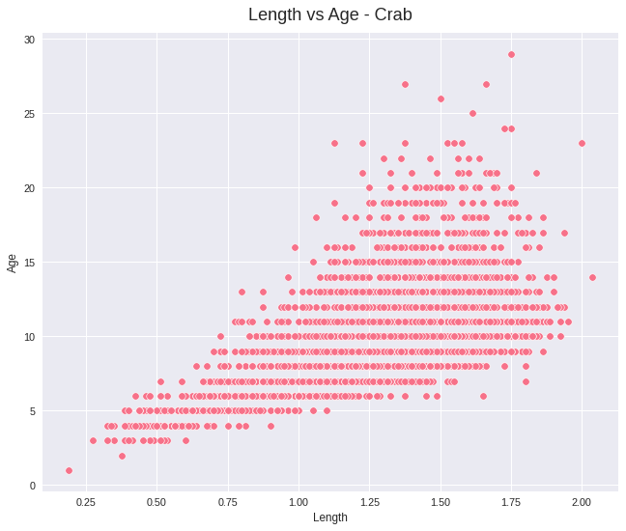
Exploratory Data Analysis: Visualizations
Scatter plot : Crab Length vs Age
Similar to the Abalone dataset, there is a clear positive correlation between length and age
13

Slide 14
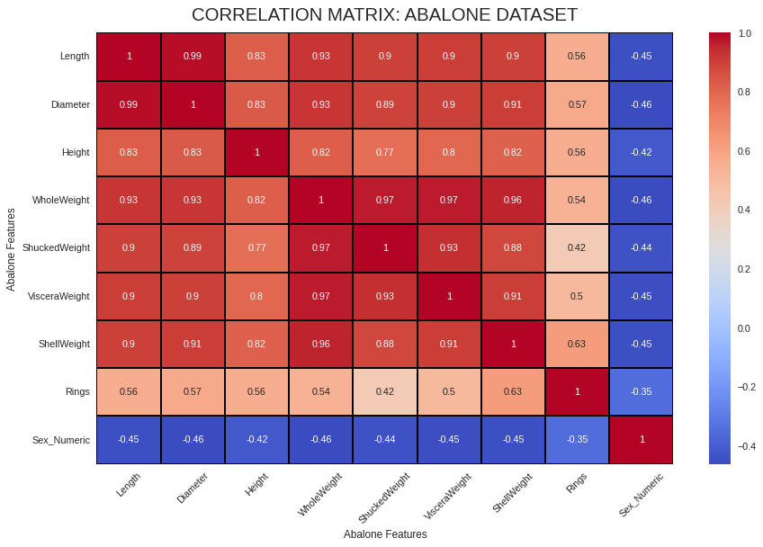
Exploratory Data Analysis: Visualizations
CORRELATION ANALYSIS: ABALONE :
We can observe strong positive correlations among most physical measurements (Length, Diameter, etc.) and moderate positive correlation between these features and 'Rings' (Age).
14

Slide 15

Exploratory Data Analysis: Visualizations
CORRELATION ANALYSIS: CRAB :
Similar to the Abalone dataset, there are strong positive correlations among the physical and weight measurements. 'Shell Weight' shows the highest positive correlation with 'Age'.
15

Slide 16
Machine Learning Models : Linear Regression
Model:
 | Linear Regression used to predict continuous age Abalone → Rings (proxy for age) Crab → Age (direct measurement)
Evaluation Metrics:
 | Mean Absolute Error (MAE) Mean Squared Error (MSE) Root Mean Squared Error (RMSE) R² Score
Results
Dataset | MAE | RMSE | R² Score
Abalone | 1.61 | 2.22 | 0.54
Crab | 1.52 | 2.16 | 0.52
16

Slide 17
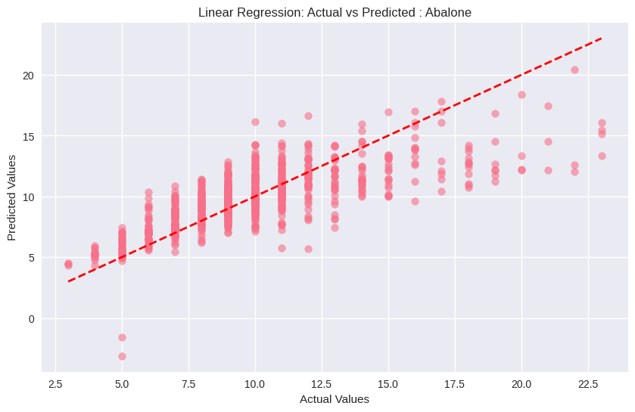
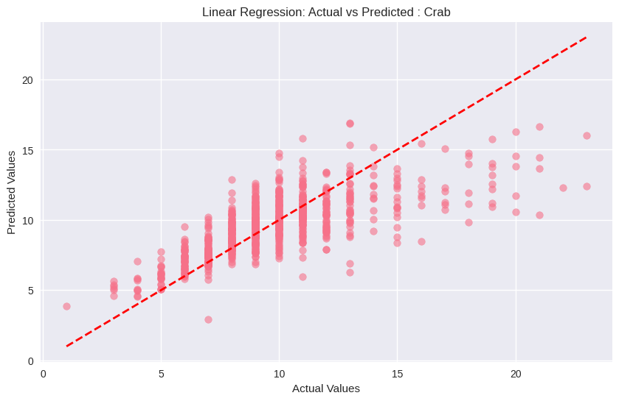
Linear Regression Insights
Linear Regression performed similarly on both datasets Explained ~52–54% of variance in age
17

Slide 18
Machine Learning Models: Logistic Regression (Abalone)
Task:
 | Binary Classification: Young → Age ≤ Median Old → Age > Median
Evaluation Metrics
Metric | Score
Accuracy | 0.7859
Precision | 0.7810
Recall | 0.7904
F1-Score | 0.7856
18

Slide 19
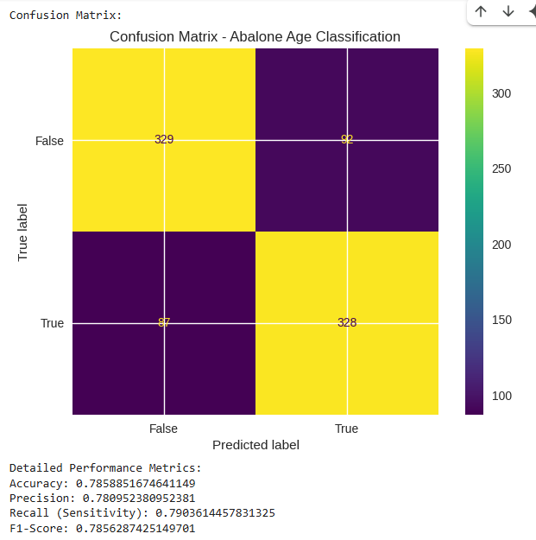
Logistic Regression Insights
Model achieved strong, balanced performance across metrics Reliable in separating Young vs. Old abalones
19

Slide 20
Machine Learning Models: Logistic Regression (Crab)
Task:
 | Binary Classification: Young → Age ≤ Median Old → Age > Median
Evaluation Metrics
Metric | Score
Accuracy | 0.7330
Precision | 0.6534
Recall | 0.4389
F1-Score | 0.5251
20

Slide 21
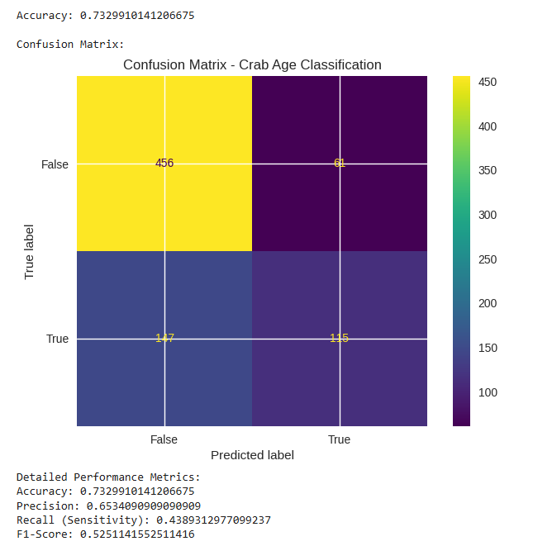
Logistic Regression Insights
Performance is weaker than Abalone Logistic Regression Especially low Recall, meaning the model struggles to correctly identify older crabs
21

Slide 22
Machine Learning Models : Support Vector Regression (SVR)
Model:
 | Support Vector Regression (SVR) used to predict continuous age
Evaluation Metrics:
 | Mean Absolute Error (MAE) Mean Squared Error (MSE) Root Mean Squared Error (RMSE) R² Score
Results
Dataset | MAE | RMSE | R² Score
Abalone | 1.51 | 2.22 | 0.55
Crab | 1.43 | 2.15 | 0.52
22

Slide 23
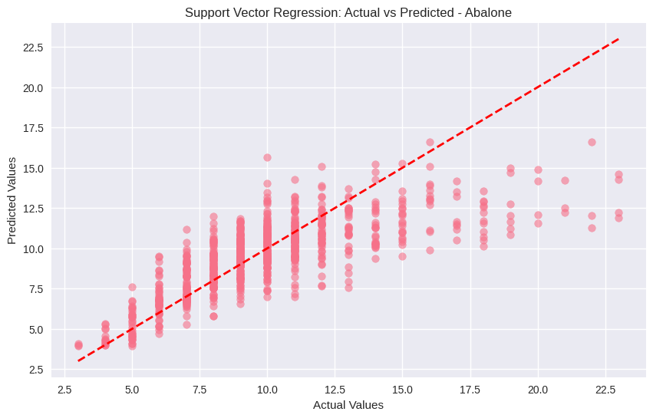
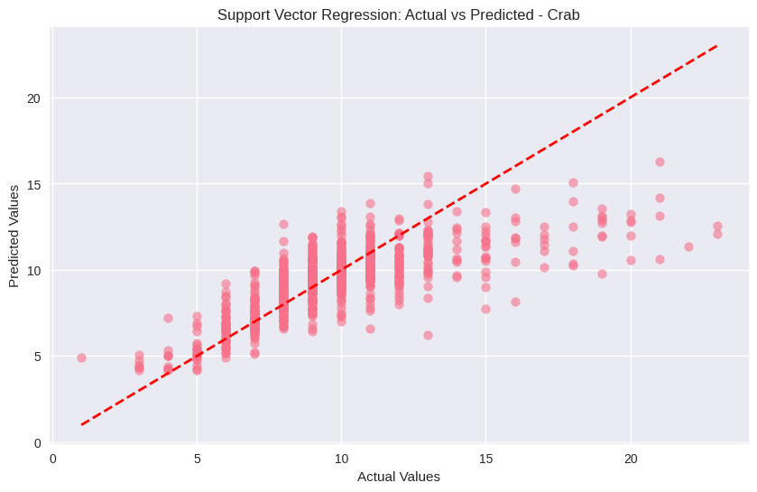
Support Vector Regression (SVR) Insights
SVR performs slightly better than Linear Regression Lower error metrics and slightly higher R² scores for both datasets
23

Slide 24
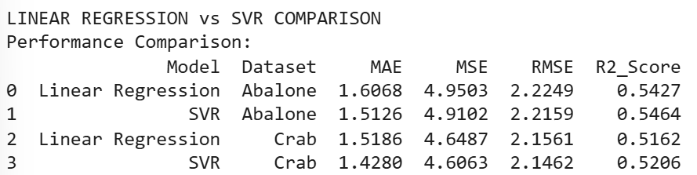
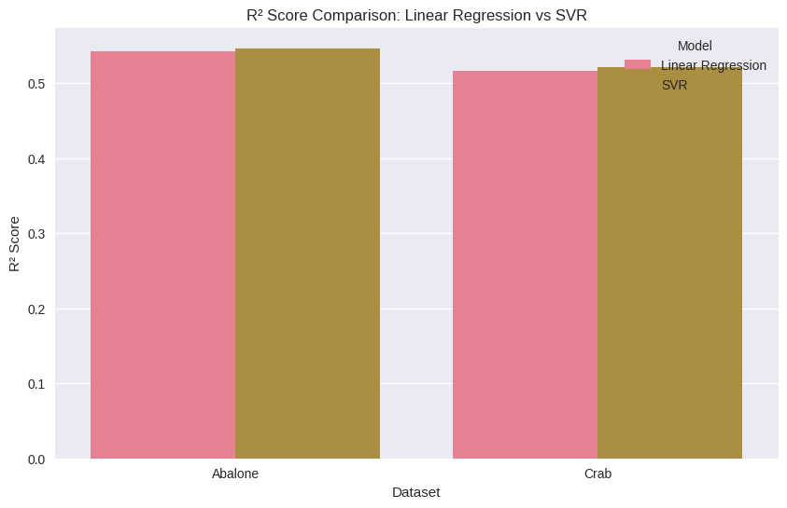
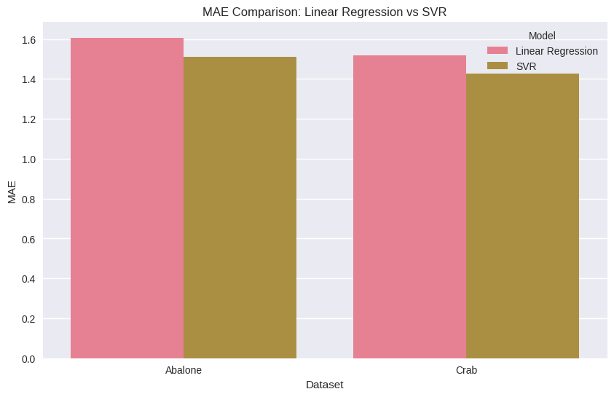
Comparative Performance Analysis
Regression Models (Linear Regression vs. SVR)
SVR slightly outperforms Linear Regression in predicting continuous age.
24

Slide 25
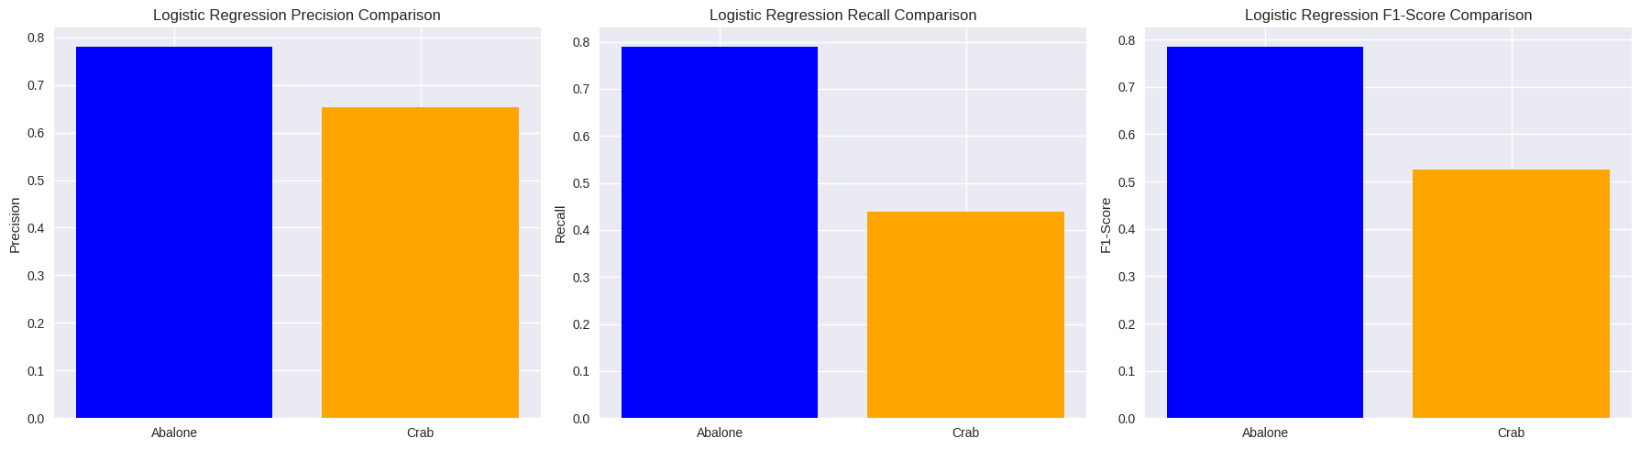
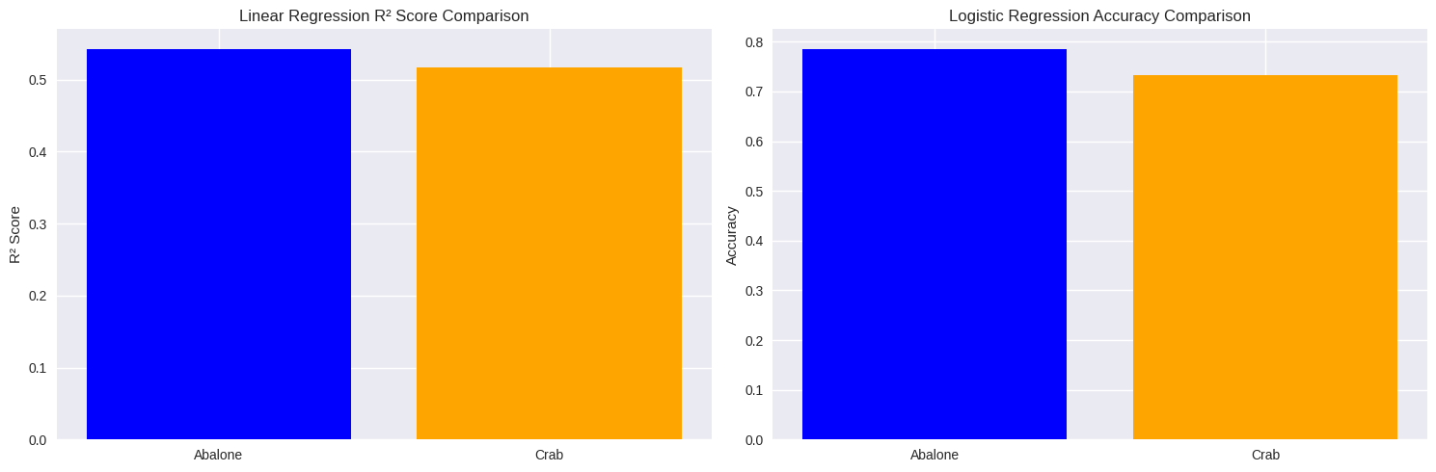
Comparative Performance Analysis
Classification Model (Logistic Regression)
Logistic Regression performs better on Abalone than Crab for binary age classification. Notably, Recall is higher for Abalone → better identification of ‘Old’ individuals.
25

Slide 26


Conclusion & Future Work
Conclusion
Future Work
Explore advanced ML models
Apply more feature engineering
Try alternative age grouping strategies for classification, especially to improve Crab dataset performance.
Physical measurements can predict the age of abalone and crabs, with moderate accuracy (R² ≈ 0.52–0.55 for regression)
SVR slightly outperforms Linear Regression for continuous age prediction.
Binary age classification (Young/Old) works better for Abalones than Crabs using Logistic Regression.
26

Slide 27
Thank
You
Feel free to ask any questions!
27

